Slide 1
DevOps For Databases – Part 2
Automation with Bilal Shahzad

Slide 2

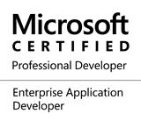


Trainer
https://www.linkedin.com/in/bilalshahzad139/
https://www.facebook.com/LearningInUrduCentre/
https://www.youtube.com/c/LearnInUrdu139
http://learninginurdu.pk
@bilalshahzad

Slide 3
Agenda
Recap of Part 1
SQLCMD Variables
DACPAC vs. BACPAC
SqlPackage.exe for Automation

Slide 4
Recap of Part 1
CI/CD of Databases
State based vs. Migration based
SSDT for Databases
State based Approach
Bringing Database in Version Control System

Slide 5
SQLCMD variables
Create variable using :setvar command
:setvar <variablename> <value>
:setvar tbname “Test2”
Select * from $(tbname)
By default SQLCMD mode is not enabled in Query Editor
Menu -> Query -> SQLCMD Mode

Slide 6
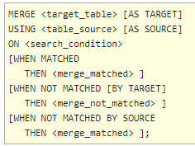
MERGE INTO
Runs insert, update, or delete operations on a target table from the results of a join with a source table.
Notes:
https://docs.microsoft.com/en-us/sql/t-sql/statements/merge-transact-sql?view=sql-server-2017

Slide 7
DACPAC
Data-Tier Application Component Packages) File
A Compressed file which contains database schema in XML format. It doesn’t contain data.
Generate DACPAC from a Database
Right click on Database name -> Tasks -> Extract Data-Tier Application
Upgrade database using a DACPAC file
Right click on Database name -> Tasks -> Upgrade Data-Tier Application

Slide 8
BACPAC
Similar to DACPAC but it also contains data.
Generate BACPAC from a Database
Right click on Database name -> Tasks -> Export Data-Tier Application
Upgrade database using a BACPAC file
Right click on Databases -> Import Data-Tier Application.
A new (or Empty) Database can be used for Import

Slide 9
SqlPackage.exe
A command-line utility that automates
Extract
Export
Publish
Import
Script
DeployReport
DiffReport
Installed with Visual Studio but you may manually download & install its latest version
https://docs.microsoft.com/en-us/sql/tools/sqlpackage?view=sql-server-2017
Path of sqlpacakge.exe
C:\Program Files (x86)\Microsoft SQL Server\<Version>\DAC\bin\sqlpackage.exe
C:\Program Files (x86)\Microsoft SQL Server\120\DAC\bin\sqlpackage.exe
Notes:
https://docs.microsoft.com/en-us/sql/tools/sqlpackage?view=sql-server-2017

Slide 10
SqlPackage.exe - Extract
To create a DACPAC file from database
sqlpackage.exe /Action:Extract /SourceServerName:"localhost\sqlexpress2014" /SourceDatabaseName:"MainDBDev" /SourceUser:sa /SourcePassword:12345 /TargetFile:" D:\DevOpsDB2\MainDBDev.dacpac"
Notes:
https://docs.microsoft.com/en-us/sql/tools/sqlpackage?view=sql-server-2017
/p:VerifyExtraction=False

Slide 11
SqlPackage.exe - Export
To create a BACPAC file from database
sqlpackage.exe /Action:Export /SourceServerName:"localhost\sqlexpress2014“ /SourceDatabaseName:"SecurityDev" /SourceUser:sa /SourcePassword:12345 /TargetFile:" D:\DevOpsDB2\DB_Export.bacpac"
Notes:
https://docs.microsoft.com/en-us/sql/tools/sqlpackage?view=sql-server-2017
This will fall over in case of objects in the source database having external references

Slide 12
SqlPackage.exe - Script
Script action creates a T-SQL incremental update script that updates the schema of a target database to match the schema of a source DACPAC. Note: Database on Source & Database on destination is possible.
sqlpackage.exe /Action:Script /SourceFile:"D:\DevOpsDB2\MainDBDev.dacpac" /TargetServerName:"localhost\sqlexpress2014" /TargetDatabaseName:"MainDBQA" /TargetUser:sa /TargetPassword:12345 /OutputPath:"D:\DevOpsDB2\diff.sql“
Notes:
https://docs.microsoft.com/en-us/sql/tools/sqlpackage?view=sql-server-2017

Slide 13
SqlPackage.exe - Publish
Compare the DACPAC with database and publish the changes to target database. Note: Database on Source & Database on destination is possible.
sqlpackage.exe /Action:Publish /SourceFile:"D:\DevOpsDB2\MainDBDev.dacpac" /TargetServerName:"localhost\sqlexpress2014" /TargetDatabaseName:"MainDBQA" /TargetUser:sa /TargetPassword:12345
Notes:
https://docs.microsoft.com/en-us/sql/tools/sqlpackage?view=sql-server-2017

Slide 14
SqlPackage.exe - Import
Load/Create new database using BACPAC file
sqlpackage.exe /Action:Import /SourceFile:"D:\DevOpsDB2\SecurityDev_Export.bacpac" /TargetServerName:"localhost\sqlexpress2014" /TargetDatabaseName:"SecurityDev" /TargetUser:sa /TargetPassword:12345
Notes:
https://docs.microsoft.com/en-us/sql/tools/sqlpackage?view=sql-server-2017

Slide 15
Demo 1
Visual Studio Schema + Data Comparison Feature
Create Script of changes
Execute changes directly to database

Slide 16
Demo 2
Create Sample databases in SQL Server
Create DB Projects for above databases in Visual Studio
Add Database Reference
Build & Check its output
Compare DB project with Physical Database
Move changes from
DB Project -> Database
Database -> DB Project
Create Publish Profile
Compare vs. Publish

Slide 17
Demo 3
Step 1: Build DB Project using MSBUILD.exe Utility (through commands)
Its like as we do “Right Click on DB Project -> Build”
This creates DACPAC file
Path of MSBuild
C:\Program Files (x86)\MSBuild\<verison>\Bin\msbuild.exe
C:\Program Files (x86)\MSBuild\14.0\Bin\msbuild.exe
MSBuild.exe <path of .sqlproj>

Slide 18
Demo 3 – Diff Script
Goal: Compare Generated DACPAC with a database and generate differential script.
Use SqlPackage.exe to do generate differential script using DACPAC + Publish profile
sqlpackage.exe /Action:Script /SourceFile:bin/debug/MainDBProj.dacpac /Profile:MainDBProj.publish.xml /TargetUser:sa /TargetPassword:12345 /TargetDatabaseName:DevOpsDB3 /OutputPath:"D:\DevOpsDB2\diff.sql"

Slide 19
Demo 3 – Publish Changes
Goal: Compare Generated DACPAC with a database and publish changes to target database.
Use SqlPackage.exe to publish changes to destination database using DACPAC + Publish profile
sqlpackage.exe /Action:Publish /SourceFile:bin/debug/MainDBProj.dacpac /Profile:MainDBProj.publish.xml /TargetUser:sa /TargetPassword:12345 /TargetDatabaseName:DevOpsDB3

Slide 20
Demo 3 – Passing Variables
Goal: Passing values to the variables while using SqlPackage.exe. Let suppose we’ve two variables (DeployDefaultValues, DummyVariable)
sqlpackage.exe /Action:Publish /SourceFile:bin/debug/MainDBProj.dacpac /Profile:MainDBProj.publish.xml /TargetUser:sa /TargetPassword:12345 /TargetDatabaseName:DevOpsDB3
/ Variables:DeployDefaultValues=1
/v:DummyVariable=1

Slide 21
Demo 4 – Pre/Post Deployment Scripts
Pre & Post Deployment scripts allow us to execute some script
Before execution of differential
After execution of differential
Final script is generated by integrating
Pre-Deployment Scripts
Differential generated by comparison
Post-Deployment Scripts
SQLCMD variables can be used in pre & post deployment scripts. Conditioning can be applied to control which script to execute based on variables.

Slide 22
Demo 4 – Publishing
Try Publish from GUI
Try Publish from SqlPackage.exe
Check the generated script
Check usage of SQLCMD variables

Slide 23
Flywaydb
Command Line Tool
https://flywaydb.org
Open Source
https://github.com/flyway/flyway
Community version is free
Pro & Enterprise versions are paid
Migration Based Approach
Notes:
https://flywaydb.org/documentation/commandline/#download-and-installation
https://github.com/flyway/flyway

Slide 24
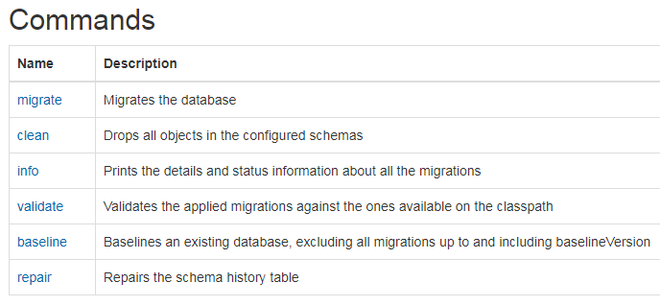
Flywaydb Commands
Notes:
https://flywaydb.org/documentation/commandline/#download-and-installation
https://github.com/flyway/flyway

Slide 25
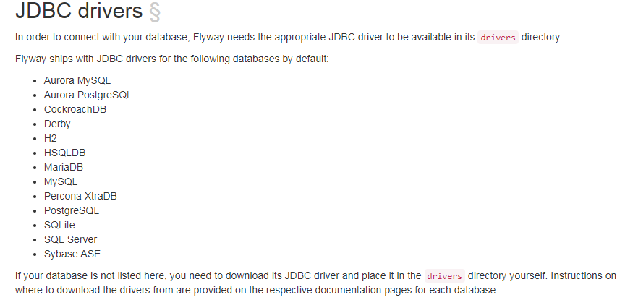
Flywaydb – (JDBC Drivers)
Notes:
https://flywaydb.org/documentation/commandline/#download-and-installation
https://github.com/flyway/flyway

Slide 26
Demo 5 – Flyway Usage
Flyway baseline
Flyway migrate
Flyway info
Flyway clean

Slide 27
One Second
Mark your Attendance
https://docs.google.com/forms/d/e/1FAIpQLSfJRkcw5CyOyzsmEUbvef5RDtcZKl4PnU8b3X52EV2n4abF0g/viewform
Feedback
https://docs.google.com/forms/d/e/1FAIpQLSeopkMnvGegk-4xDqju26PGaXLl0L19Mte45lbKW1qCm-yBuA/viewform
Material
https://docs.google.com/spreadsheets/d/1LaeIrpanrKKeEkBIPPCWbbqnP8loNnm7RjlgVe1T61Y/edit#gid=999102021

Slide 28


Slide 29
Thank You

